Slide 1
Introduction to Quantum Computing: From a Layperson to a Programmer in 30 Steps
Hiu-Yung Wong
https://link.springer.com/book/10.1007/978-3-030-98339-0
https://www.amazon.com/Introduction-Quantum-Computing-Layperson-Programmer/dp/3030983382
Playlist: https://www.youtube.com/watch?v=l8WmAHLcLnc&list=PLnK6MrIqGXsJfcBdppW3CKJ858zR8P4eP&index=13
https://www.youtube.com/watch?v=cx3HLmyxBGs&list=PLnK6MrIqGXsJfcBdppW3CKJ858zR8P4eP&index=14

Slide 2
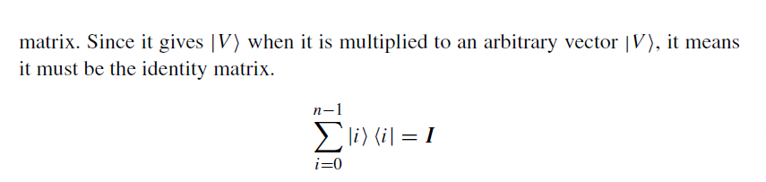

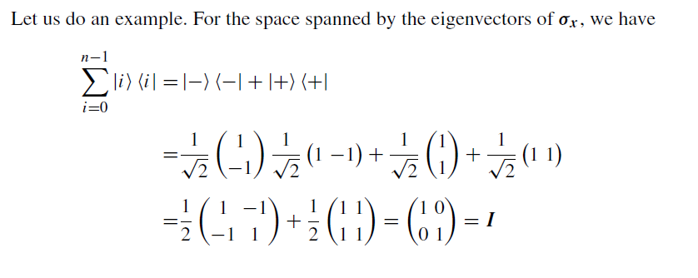
Completeness Examples

Slide 3





Projection Operator
Here Pi is the projection operator that will project an arbitrary vector |Ψ to the subspace spanned by |i.
Overall Inner Product

Slide 4





Finding the Probability of Getting Certain Result in Measurement

Slide 5
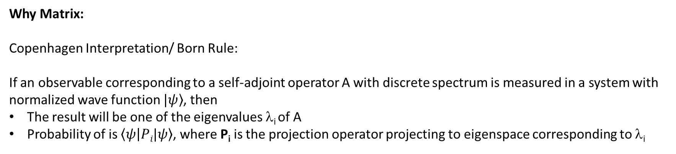
Matrix (Now, you should understand what we said earlier)
Why Matrix:
Copenhagen Interpretation/ Born Rule:
If an observable corresponding to a self-adjoint operator A with discrete spectrum is measured in a system with normalized wave function $|\left.ψ\right\rangle$, then
The result will be one of the eigenvalues λ_{i} of A
Probability of is $\left\langle ψ | Pi|ψ\right\rangle$, where P_{i} is the projection operator projecting to eigenspace corresponding to λ_{i}
You also understand now:
What is self-adjoint matrix
How to find the eigenvector and values/ diagonalize a matrix
More Bra-Ket operations

Slide 6
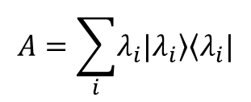
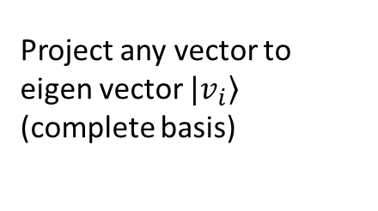
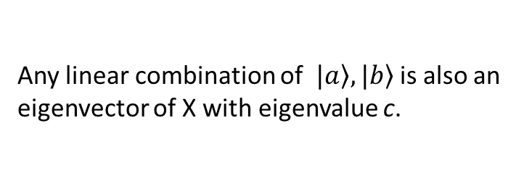
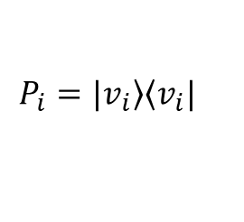
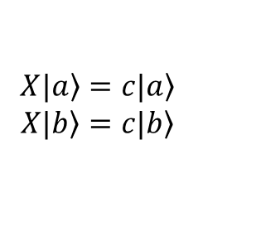
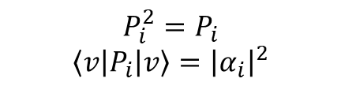
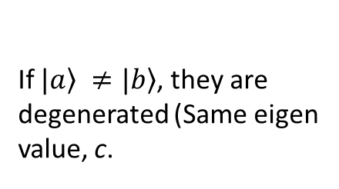
Summary
Projection Operator/ Projector
$$P_{i}=\left.|v_{i}\right\rangle \left\langle v_{i}|\right.$$
Project any vector to eigen vector $\left.|v_{i}\right\rangle$ (complete basis)
$$P_{i}^{2}=P_{i}$$
$$\left\langle v | P_{i} | v\right\rangle ={\left|α_{i}\right|}^{2}$$
Degeneracy
$$X\left.|a\right\rangle =\left.c|a\right\rangle$$
$$X\left.|b\right\rangle =\left.c|b\right\rangle$$
If $\left.|a\right\rangle ≠\left.|b\right\rangle$, they are degenerated (Same eigen value, c.
Any linear combination of $\left.|a\right\rangle ,\left.|b\right\rangle$ is also an eigenvector of X with eigenvalue c.
Construction of operator from given eigenvalues and eigenvectors
$$A=\sum_{i}{\left.λ_{i}|λ_{i}\right\rangle \left\langle λ_{i}|\right.}$$

Slide 7

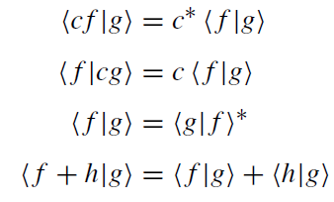
Hilbert Space
Any pair of vectors, If> and |g>, and for any complex number, c, with the following properties
Any Finite dimensional vector space with inner product is a Hilbert Space

Slide 8
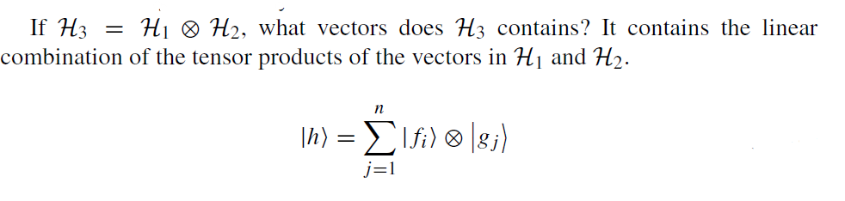
Tensor Product of Hilbert Space

